Slide 1
Error Detection:
Repetition and Hamming Codes

Slide 2
What are Error Detection Codes?
Techniques to detect errors in transmitted or stored data
Add redundancy to original data in a specific way
Redundancy enables error checking and potential

Slide 3
This presentation will focus on two specific error detection and correction techniques:
Repetition Codes
Hamming Codes

Slide 4
01
Problem Statement

Slide 5
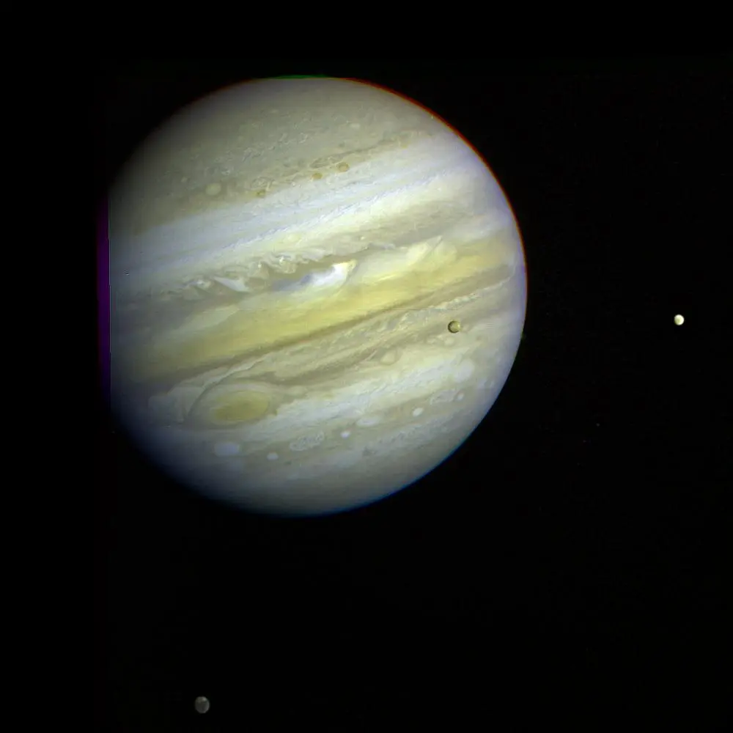

Satellite Transmissions
When transmitting satellite images across MILES, bits are bound to be randomly flipped by interference (electromagnetic waves).
For images being used for scientific discovery and analysis, it’s important to ensure high accuracy and clarity

Slide 6
02
Repetition Code
Implementation

Slide 7
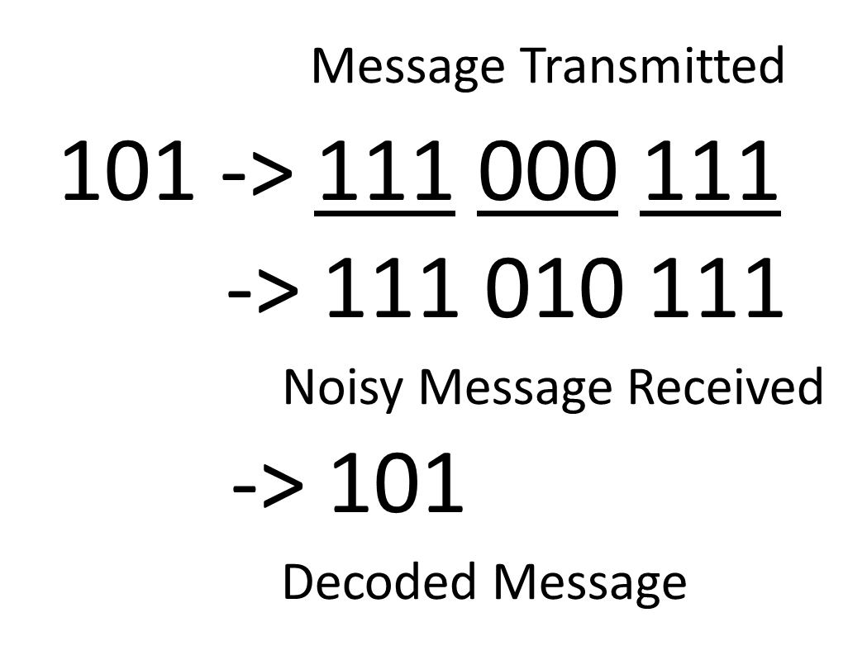
Repetition (3,1) Code
In this error correction method, three bits are sent, one of which is the desired bit.

Slide 8
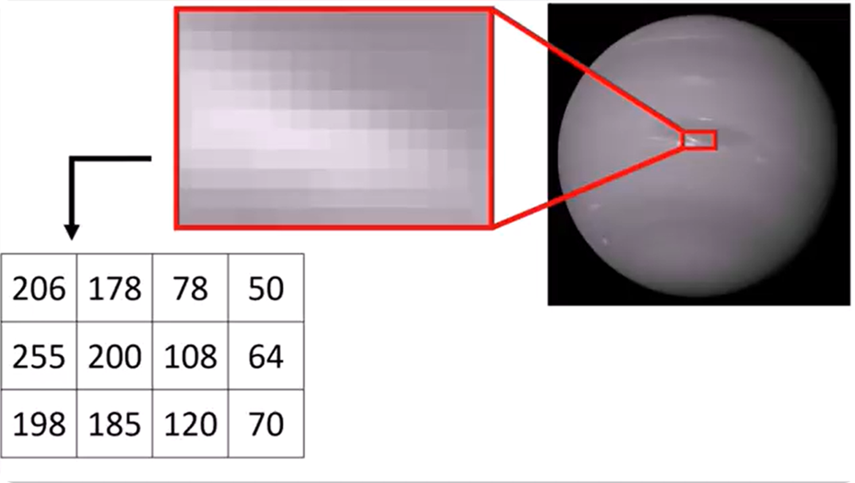
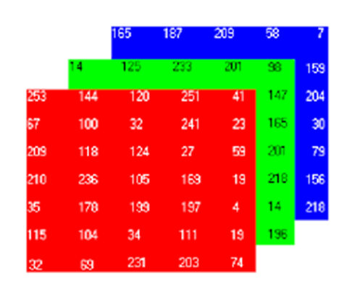
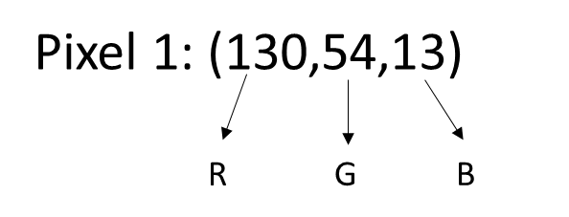
Error Detection in Images using Repetition

Slide 9
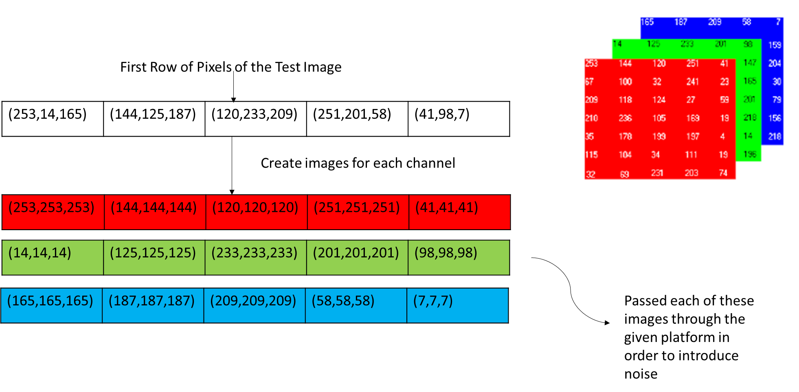
Encoding Process

Slide 10
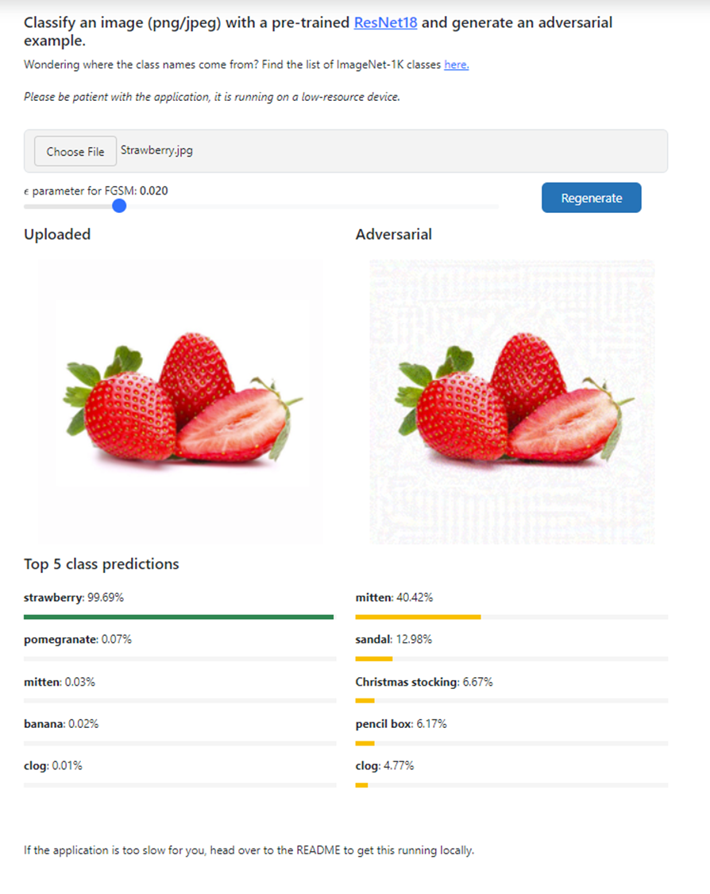

Slide 11
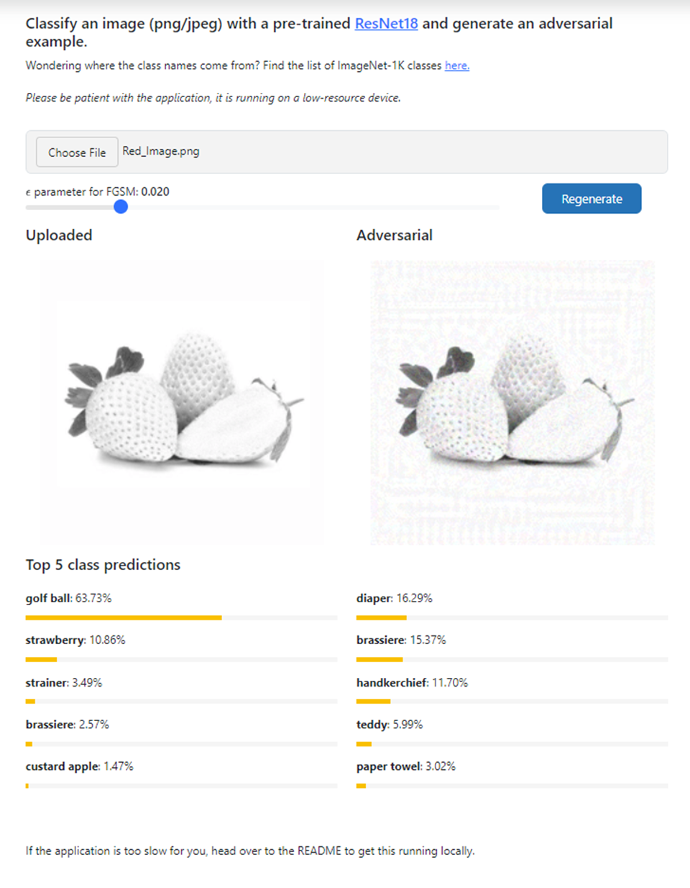



Slide 12
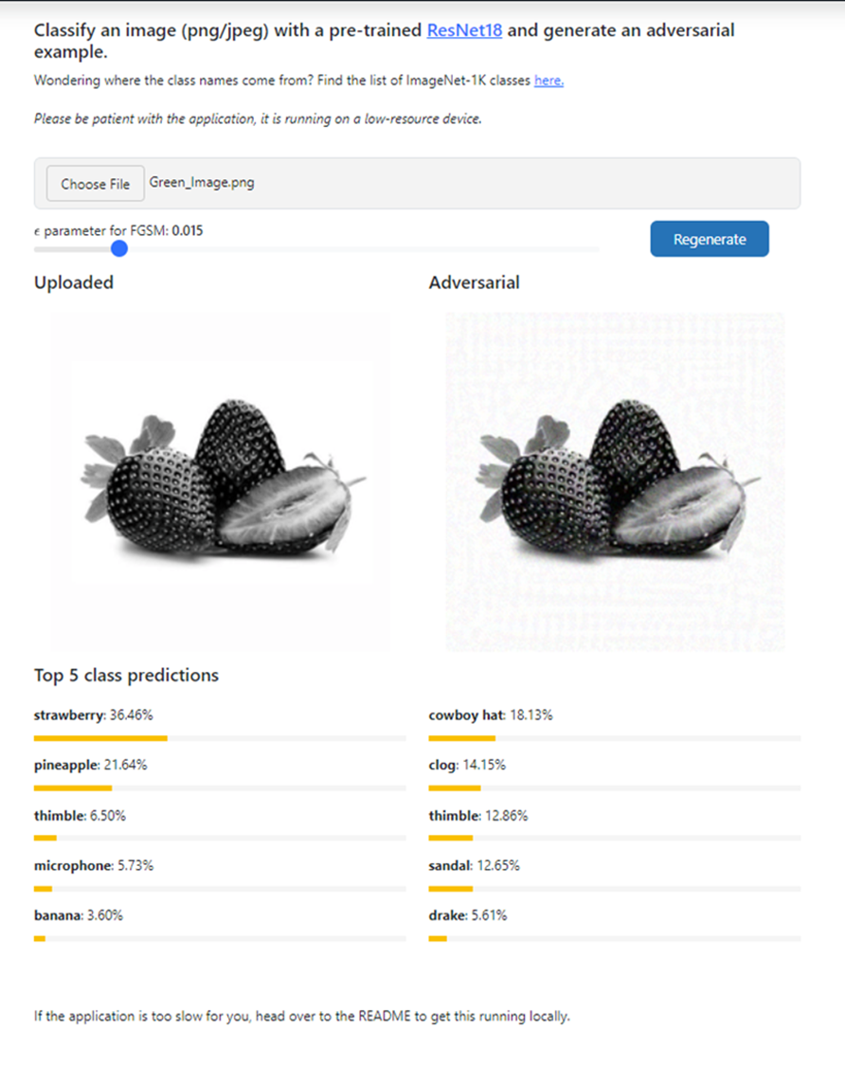

Slide 13
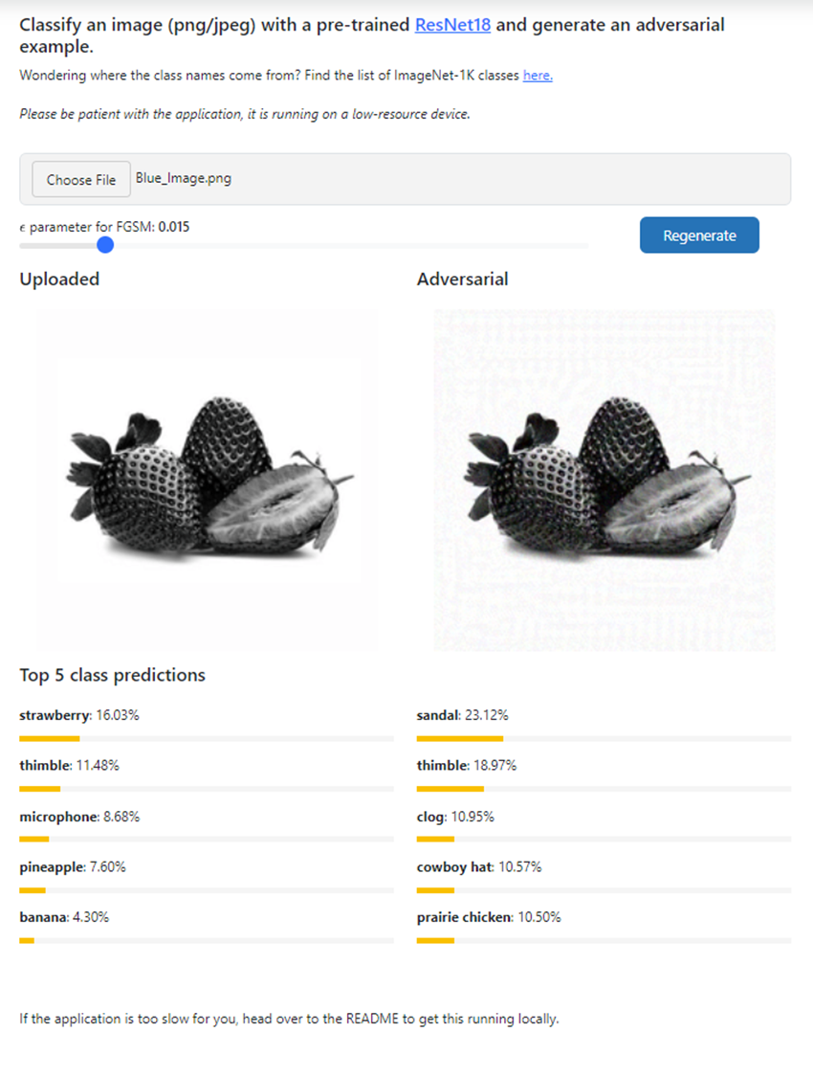

Slide 14
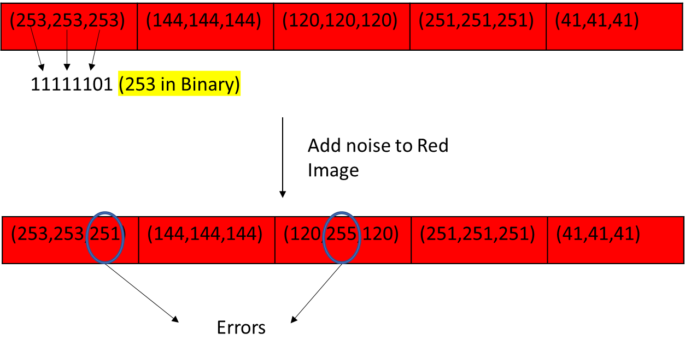
Decoding Process

Slide 15
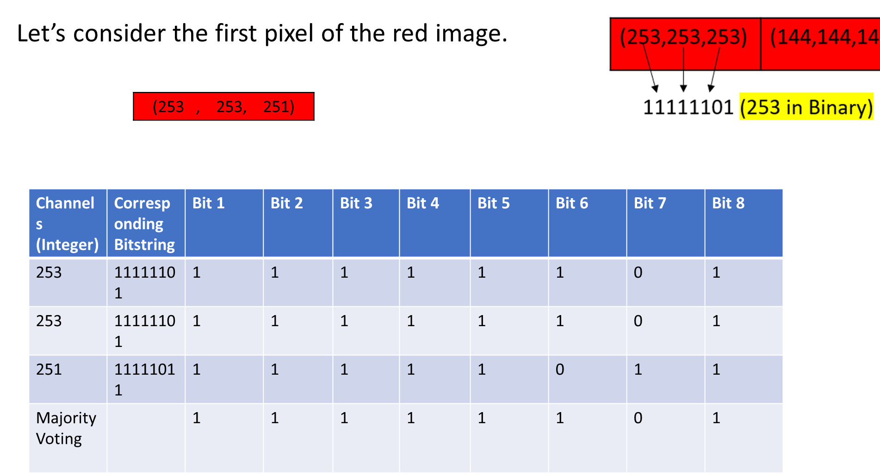
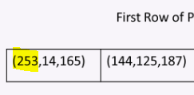

Slide 16
Combine the three channels
We perform the same operation for all the pixels in the red, green, and blue images with noise.
After decoding, we create a new image by combining the corrected R, G, and B values for each pixel.

Slide 17


Slide 18
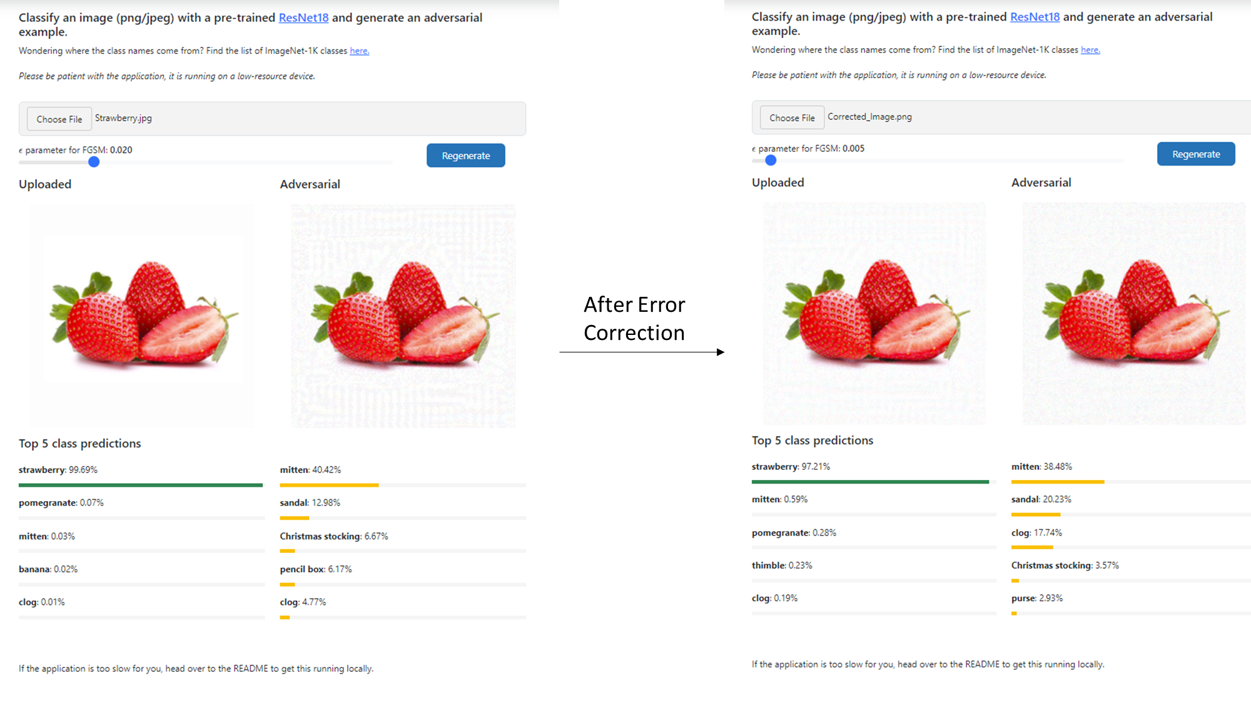

Slide 19
03
The Math Behind It
How we approach calculating Repetition Code probability

Slide 20
Modeling Repetition Code
Goal: Model the probability we don’t catch an error
Narrow scope to ONE bit:
Each bit is an IID
Each repetition is an IID
Let X denote the event that that the transmitted bit is flipped with probability p
X ~ Bernoulli(p)

Slide 21
Modeling Repetition Code
Goal: Model the probability we don’t catch an error
Narrow scope to ONE bit:
Each bit is an IID
Each repetition is an IID
Let X denote the event that that the transmitted bit is flipped with probability p
X ~ Bernoulli(p)
If we perform repetition n times,
Let S = X₁+X₂+ ᐧᐧᐧ +X_{n}
S ~ Binomial (n, p)

Slide 22
Modeling Repetition Code
Goal: Model the probability we don’t catch an error
P(S=5) means the probability that 5
out of n bits got flipped
Since we want the probability that the bit is flipped more than half of the time
P(not detecting error)
= P(majority bits are flipped)
= P(S > n/2)

Slide 23
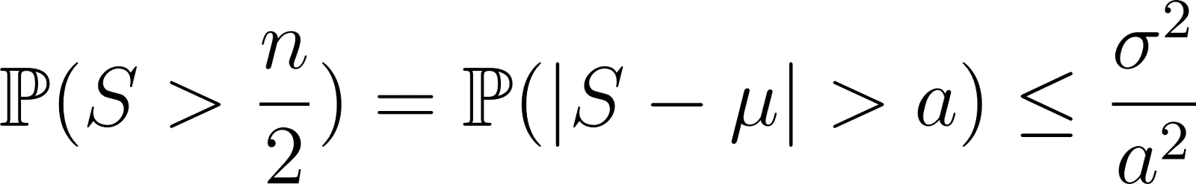
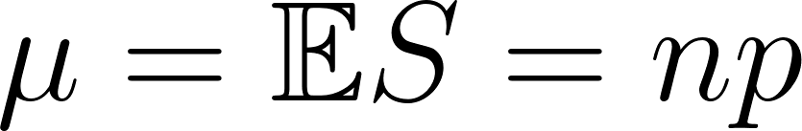
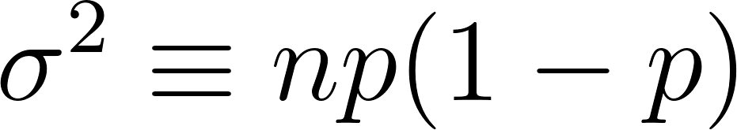
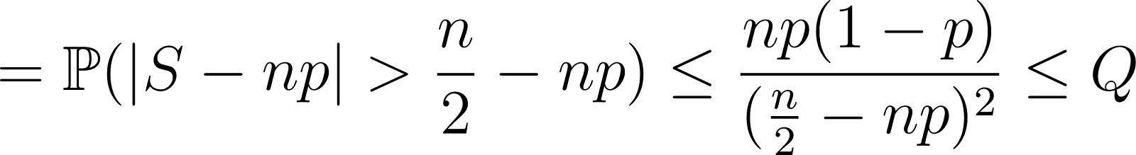
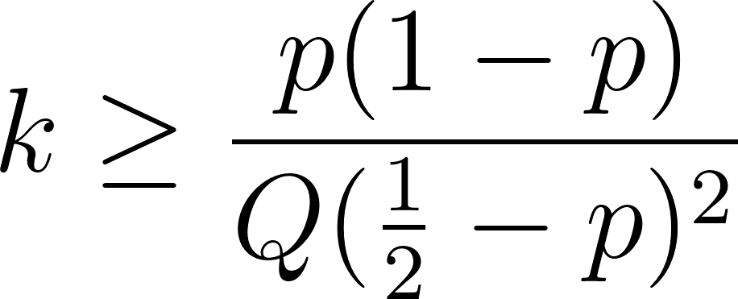
Using Chebyshev’s Inequality
“How big n should be to reach a certain accuracy?”
Chebyshev’s inequality:
→ : min repetition needed
Ex. Threshold accuracy of 0.99 (Q=0.01)
and p=0.3,
k>=525; but not guaranteed a tight bound.

Slide 24
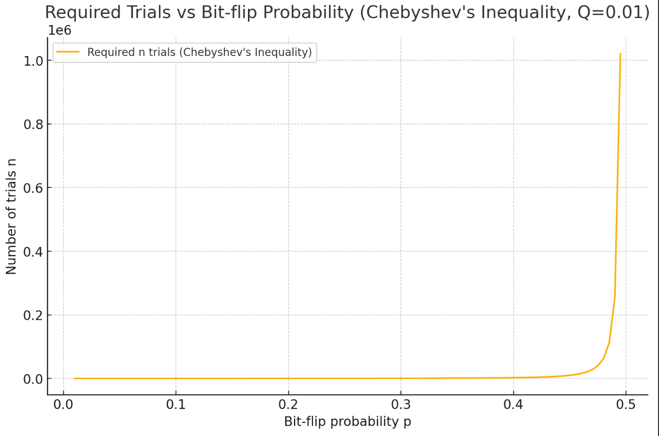
Using Chebyshev’s Inequality
“How big n should be to reach a certain accuracy?”
Chebyshev’s inequality:
→ : min repetition needed
Ex. Threshold accuracy of 0.99 (Q=0.01)
and p=0.3,
k>=525; but not guaranteed a tight bound.
p=0.5: random flipping
p=0.2~0.4: real-world error rates
N.b. ensures a very conservative bound

Slide 25
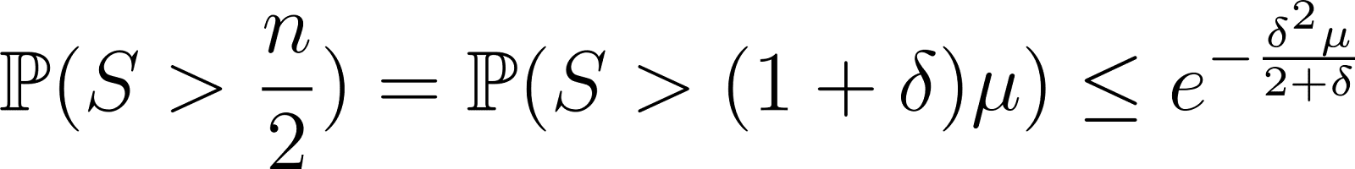
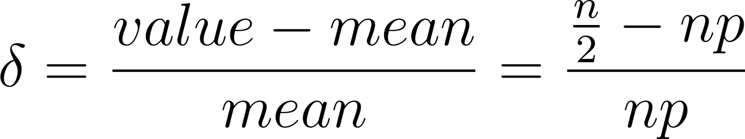
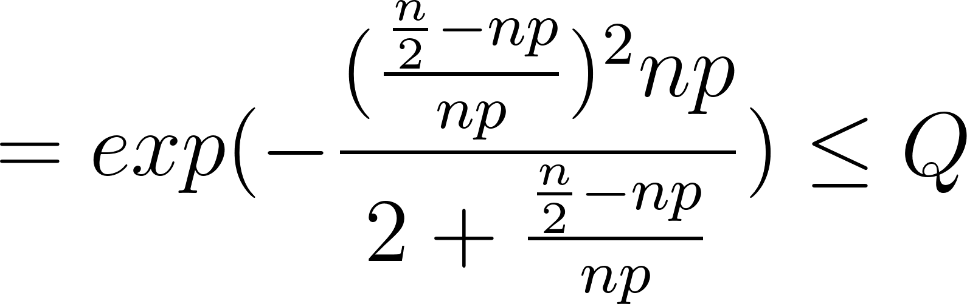
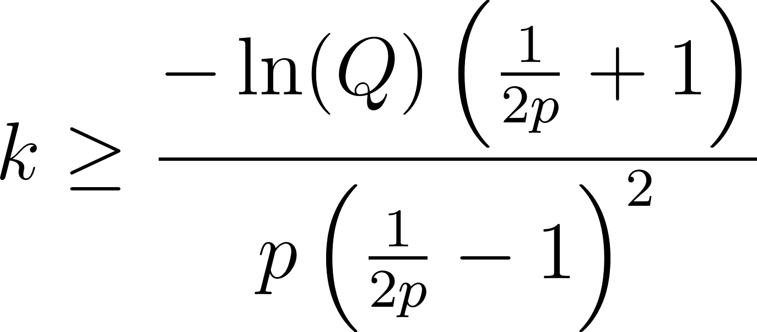
Using Chernoff’s Bound
“How big n should be to reach a certain accuracy?”
Chernoff bound: tighter bound for sums of independent random variables
→ : min repetition needed
: relative deviation from the mean
Ex. Threshold accuracy of 0.99 (Q=0.01)
and p=0.3,
k>=92.1

Slide 26
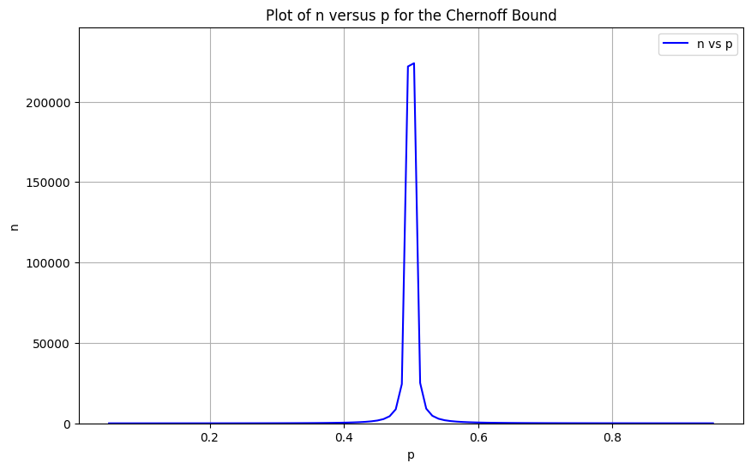
Using Chernoff’s Bound
“How big n should be to reach a certain accuracy?”
Chernoff bound: tighter bound for sums of independent random variables
→ : min repetition needed
: relative deviation from the mean
Ex. Threshold accuracy of 0.99 (Q=0.01)
and p=0.3,
k>=92.1
Better estimate:
Exponential decrease of upper bound
Leverage for independence

Slide 27
04
Hamming Code
Implementation

Slide 28
Overview of Hamming codes
Hamming codes are error-correcting codes that detect and correct single-bit errors.
They add parity bits to data bits to identify and fix errors.
Hamming(7,4) has 4 data bits and 3 parity bits.

Slide 29
Encoding: Hamming(7,4)
The encoding process for Hamming involves calculating parity bits based on the original data bits. The parity bits are placed at specific positions.
Suppose we want to encode the 4-bit data 1011.
Bit Positions:
The total bit positions are numbered: 1, 2, 3, 4, 5, 6, 7.
Data bits go in positions 3, 5, 6, and 7.
Parity bits are placed at positions 1, 2, and 4.
Encoding Structure: p1 p2 d1 p3 d2 d3 d4 _ _ 1 _ 0 1 1

Slide 30
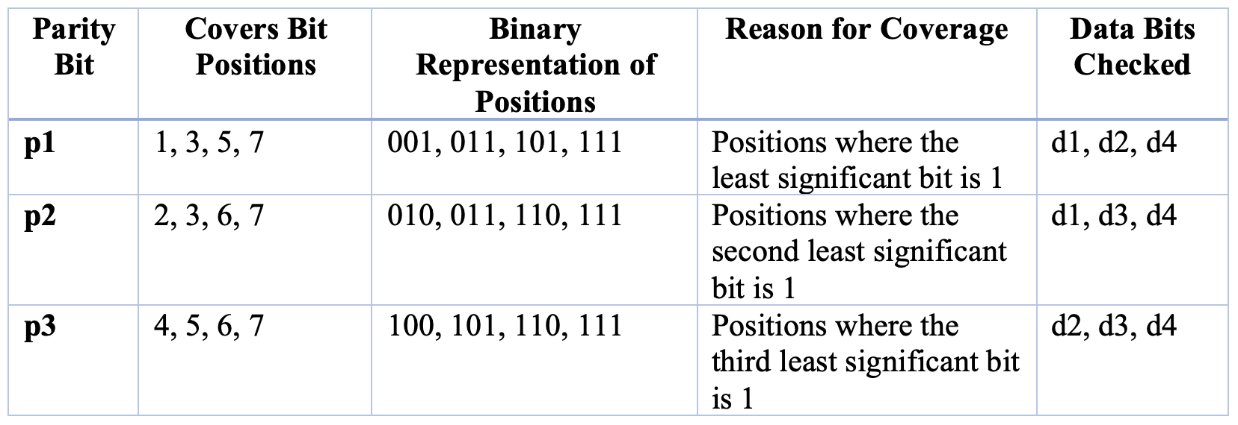
Calculating Parity Bits
p1: Covers bits 1, 3, 5, 7 p1 = d1 ⊕ d2 ⊕ d4 = 1 ⊕ 0 ⊕ 1 = 0
p2: Covers bits 2, 3, 6, 7 p2 = d1 ⊕ d3 ⊕ d4 = 1 ⊕ 1 ⊕ 1 = 1
p3: Covers bits 4, 5, 6, 7 p3 = d2 ⊕ d3 ⊕ d4 = 0 ⊕ 1 ⊕ 1 = 0
Now we fill in the parity bits: p1 p2 d1 p3 d2 d3 d4 = 0 1 1 0 0 1 1
The final encoded 7-bit message is 0110011.

Slide 31
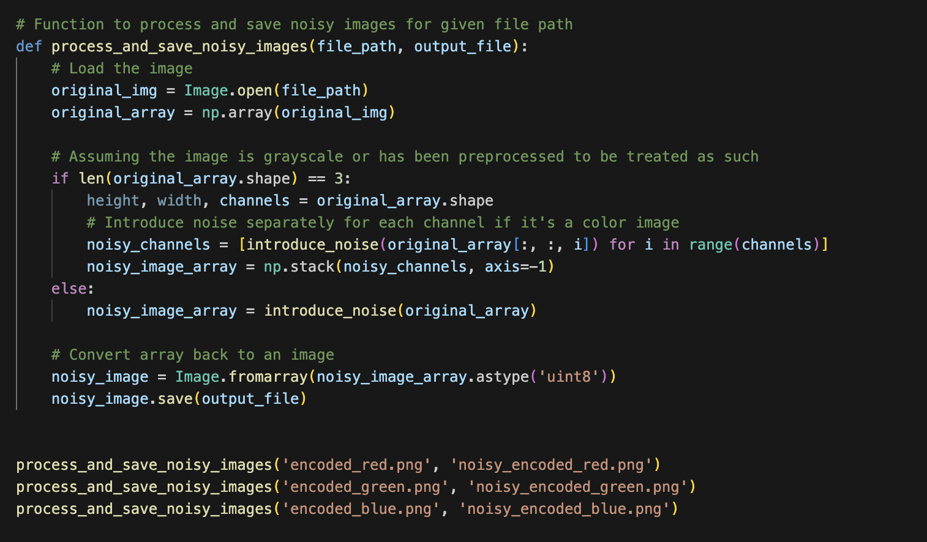
Noisy Algorithm
Processing and Saving Noisy Images
process_and_save_noisy_images(file_path, output_file):
Loads the image, introduces noise, and saves the noisy version.
If the image is in color, noise is added to each channel (red, green, blue) individually.

Slide 32
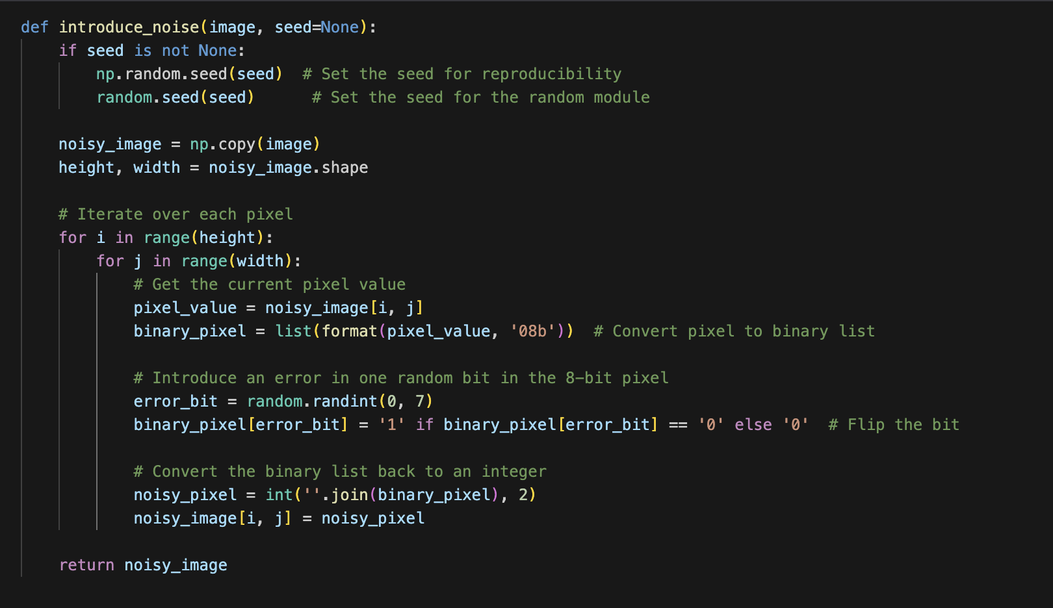
Noisy Algorithm
Introducing Noise in the Image
introduce_noise(image, seed=None):
Converts each pixel of an image to an 8-bit binary number.
Randomly flips one bit per pixel to simulate noise.
Ensures reproducibility of the noise by allowing a seed value.

Slide 33


Encoded Red
Red with Noise

Slide 34

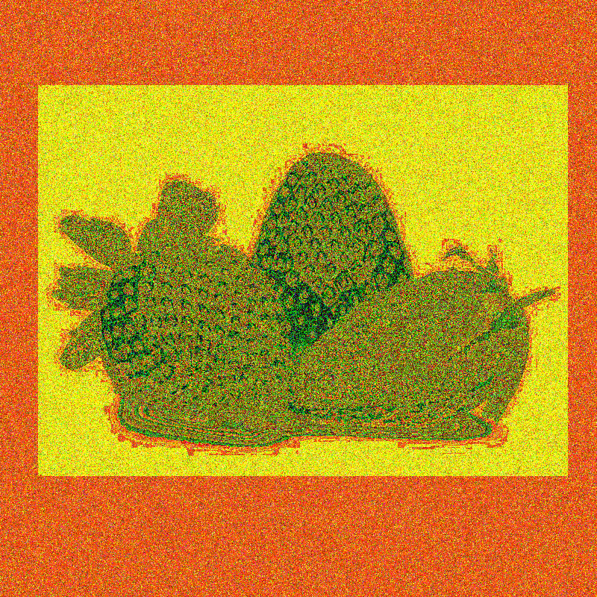
Encoded Green
Green with Noise

Slide 35

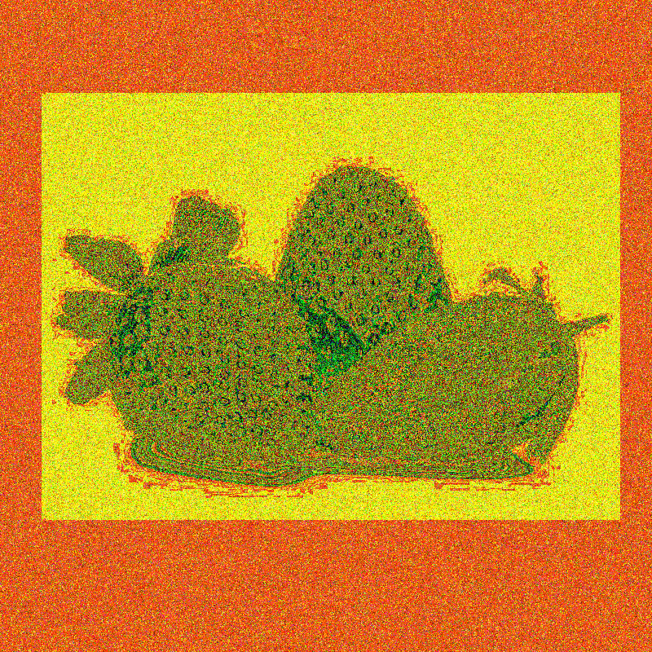
Encoded Blue
Blue with Noise

Slide 36
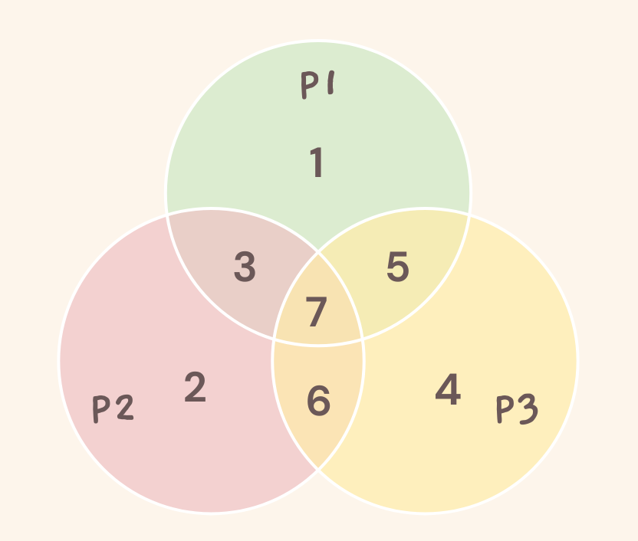
Decoding: Hamming(7,4)
p1: Covers bits 1, 3, 5, 7 p1 = d1 ⊕ d3 ⊕ d5 ⊕ d7 = 0 ⊕ 1 ⊕ 0 ⊕ 1 = 0
p2: Covers bits 2, 3, 6, 7 p2 = d2 ⊕ d3 ⊕ d6 ⊕ d7= 1 ⊕ 1 ⊕ 0 ⊕ 1 = 1
p3: Covers bits 4, 5, 6, 7 p3 = d4 ⊕ d5 ⊕ d6 ⊕ d7 = 0 ⊕ 0 ⊕ 0 ⊕ 1 = 1
Error is located at position: 6
0110001 received with a single-bit error corrected to 0110011

Slide 37
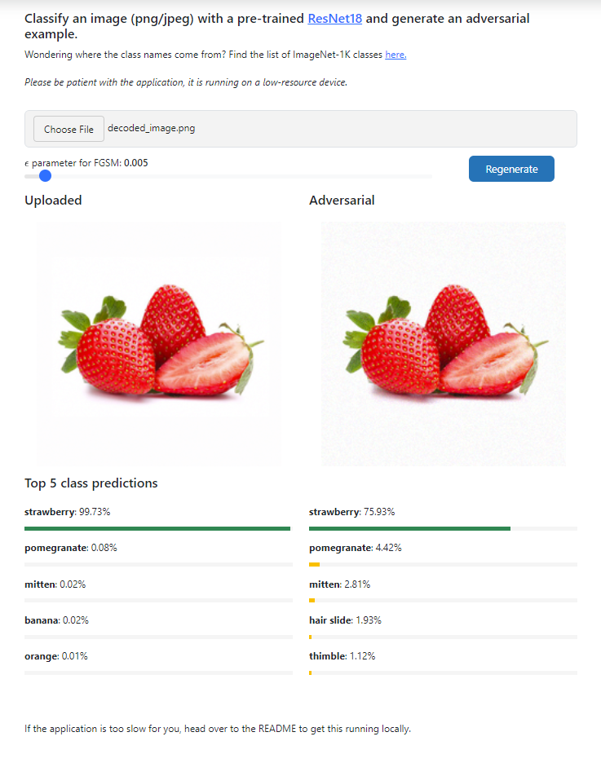

Slide 38
05
The Math Behind It
How we approach calculating Hamming Code probability

Slide 39
Modeling Hamming Code
Goal: Model the probability can correct an error and get initial data
Discuss Hamming (7,4)
Discuss transmitting 4 bits
Assume probability of a bit flipping is p.

Slide 40
Modeling Hamming Code
Goal: Model the probability can correct an error and get initial data
0 1 1 0 0 1 1
Probability of no bit flips: (1-p)*(1-p)*(1-p)*(1-p)*(1-p)*(1-p)*(1-p) = (1-p)⁷
Probability of 1 bit flips: p*(1-p)*(1-p)*(1-p)*(1-p)*(1-p)*(1-p)
(1-p)*p*(1-p)*(1-p)*(1-p)*(1-p)*(1-p)
(1-p)*(1-p)*p*(1-p)*(1-p)*(1-p)*(1-p)
. . .
= 7*p*(1-p)⁶
Probability of Hamming code working = (1-p)⁷ + 7*p*(1-p)⁶

Slide 41
Modeling Hamming Code
Goal: Model the probability can correct an error and get initial data
Probability of Hamming code working = (1-p)⁷ + 7*p*(1-p)⁶
We can compare to transmitting without Hamming code:
1 0 1 1
(1-p)*(1-p)*(1-p)*(1-p) = (1-p)⁴

Slide 42
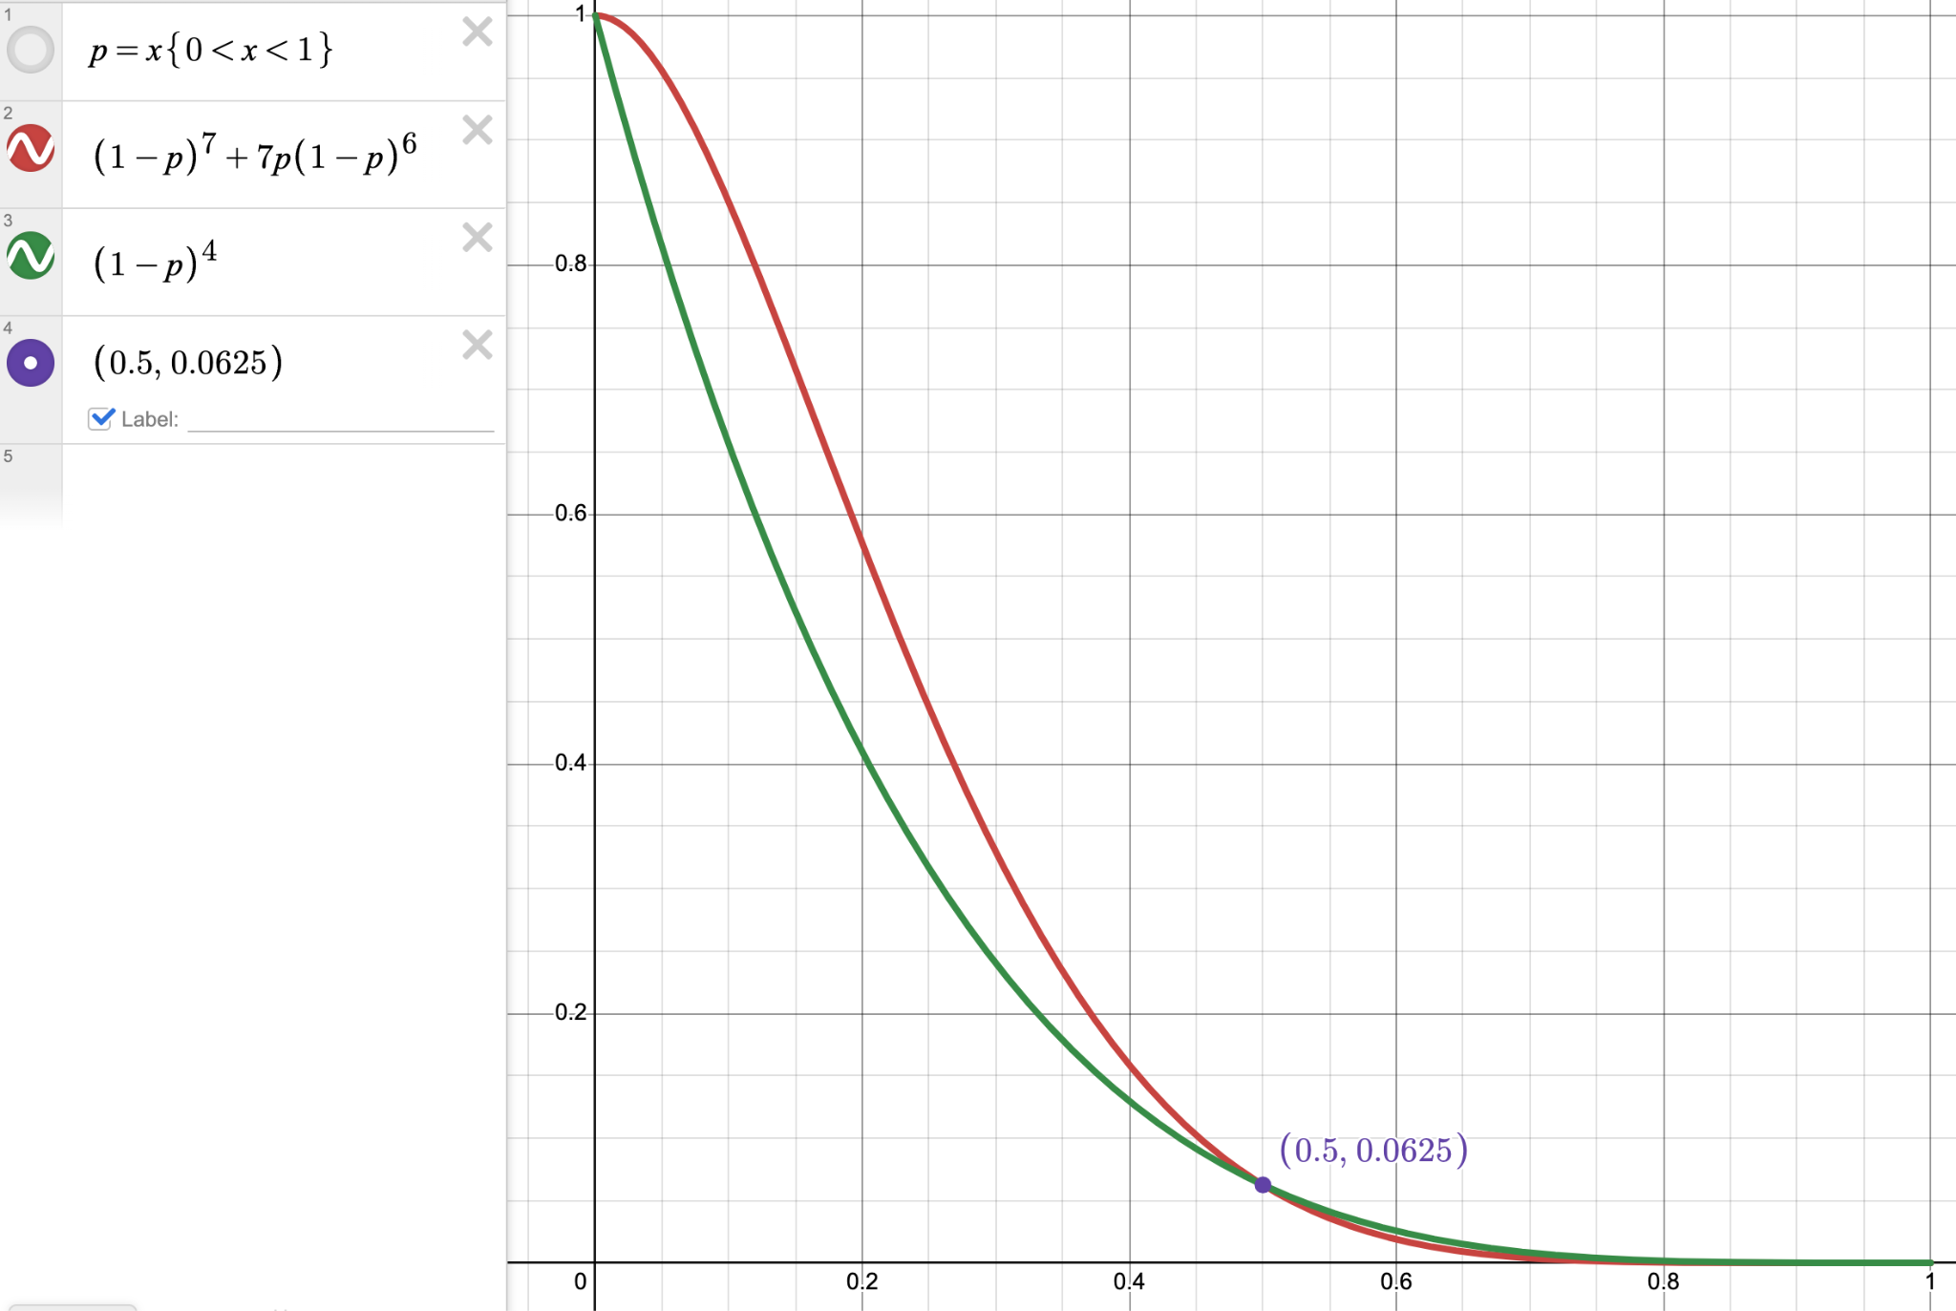
Modeling Hamming Code
Goal: Model the probability can correct an error and get initial data

Slide 43
Modeling Hamming Code
Goal: Model the probability can correct an error and get initial data
“Calculations with iron cosmic rays resulted in an event rate of 3.1 x 10⁻³ per transistor per year, in reasonable agreement with the observed rate of 1.5 x 10⁻³.”
(IEEE Xplore Full-Text PDF:, 2016)

Slide 44
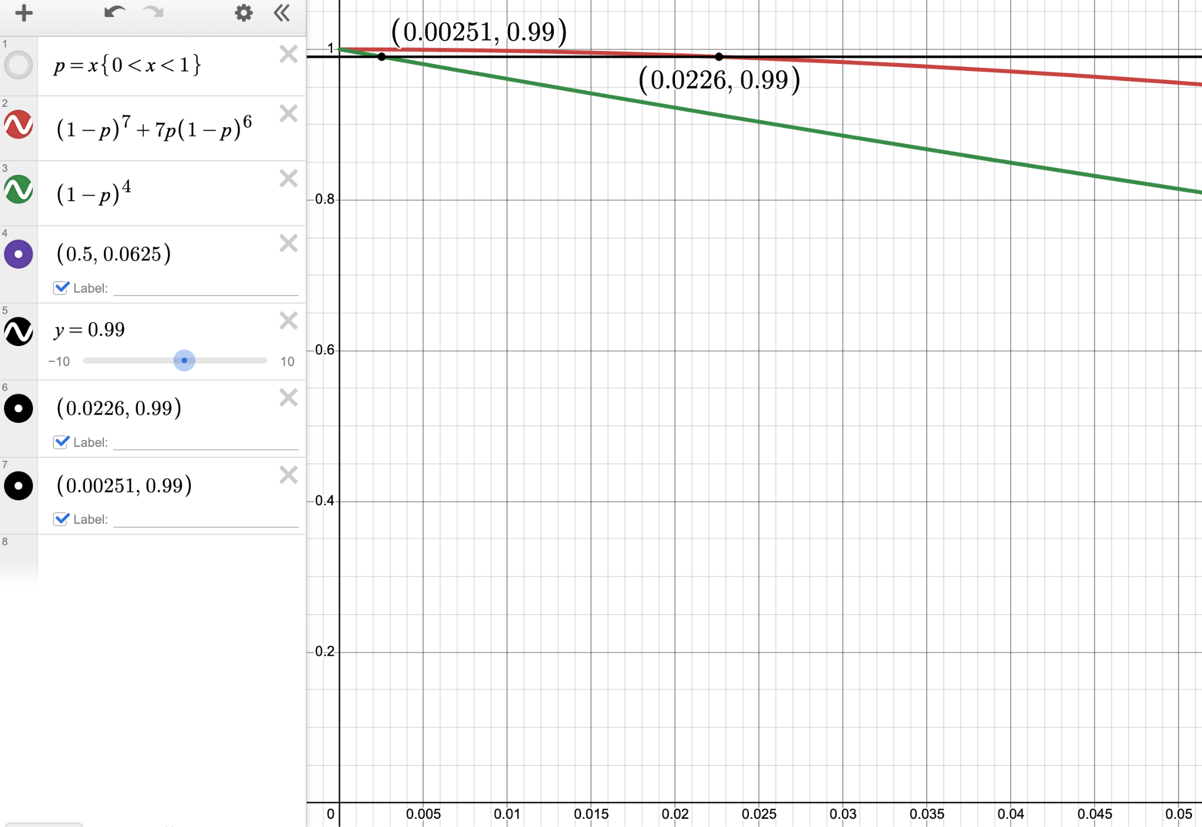
Modeling Hamming Code
Goal: Model the probability can correct an error and get initial data

Slide 45
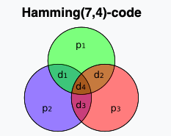
Hamming Code
An error-correcting technique that detects and corrects single-bit errors by adding parity bits to data bits. It is particularly useful in environments where single-bit errors are common but multi-bit errors are rare.

Slide 46
Benefits
Hamming codes are effective at detecting and correcting single-bit errors, providing an efficient error-correcting method.
The use of parity bits allows the identification and correction of errors with minimal redundancy.

Slide 47
Limitations
Primarily limited to correcting only single-bit errors, meaning they cannot handle multiple-bit errors effectively.
More complex to implement than simple repetition codes, requiring specific calculations for parity bit placement and error detection.

Slide 48
Repetition Code
A simple error detection and correction technique where each bit of data is transmitted multiple times. The idea behind this method is to ensure that even if some bits are corrupted during transmission, the receiver can use the repeated bits to identify and correct the errors.

Slide 49
Benefits
One of the biggest advantages of the (3,1) code is its simplicity. It's straightforward to implement, as it requires only the replication of bits.
In environments where noise is minimal, the (3,1) repetition code is highly reliable because the likelihood of all three bits being corrupted is low.

Slide 50
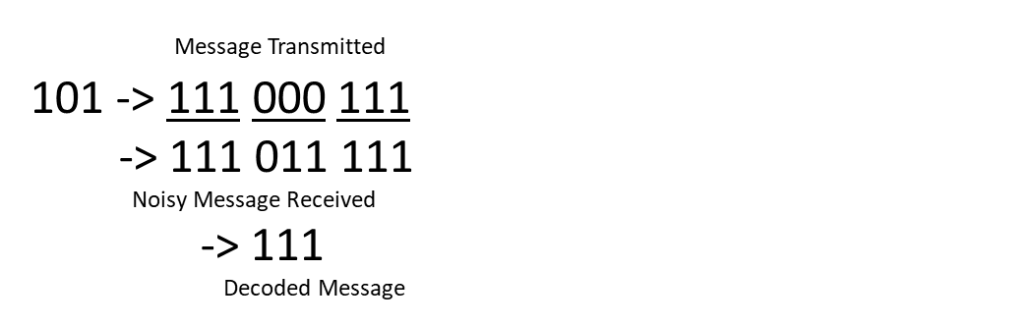
Limitations
For every bit of original data, we now send three bits, which could be inefficient compared to more complex codes that use less redundancy.
While effective in low noise environments, its performance drops significantly as the noise level increases. In high noise environments, the probability that two out of three bits are corrupted increases, leading to incorrect decoding.

Slide 51
Thank You!

Slide 52
Resources
IEEE Xplore Full-Text PDF: (2016). Ieee.org.
https://ieeexplore.ieee.org/stamp/stamp.jsp?tp=&arnumber=4328188
ChatGPT
‌

